Slide 1

Data Representation and Analysis
Session 4: Making Charts and Your First Analysis Project
Hasitha Pramuditha

Slide 2

Welcome Back to Our Final Session!
Last time, we became data detectives!
We learned to find and fix common data problems (missing values, duplicates, wrong formats).
We practiced sorting, filtering, and creating new columns.

Slide 3

Today's Grand Finale: Bringing Data to Life!
Learning Objectives:
Create simple charts to show your data.
Make charts that are easy to understand.
Complete a full analysis from start to finish.
Present your findings clearly.

Slide 4
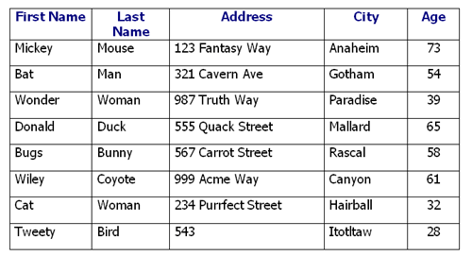
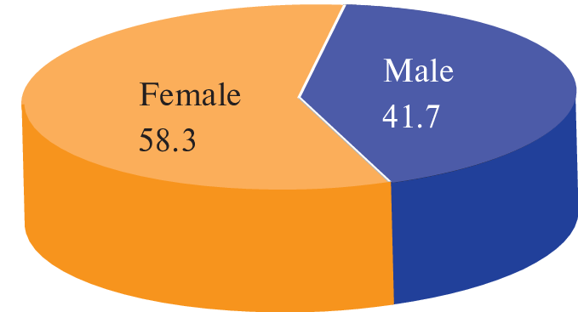
Why Make Charts? Numbers vs. Pictures
Numbers are hard to understand quickly: A long list of numbers doesn't tell a story.
Pictures are easy! Charts help us see patterns, trends, and outliers at a glance.
Charts are essential for explaining your findings to others (and to yourself!).

Slide 5

Our Charting Tool: Matplotlib
Just like Pandas helps with tables, Matplotlib is a powerful Python library for making charts.
It's widely used and can create almost any type of plot.
We usually import it as plt for short: import matplotlib.pyplot as plt

Slide 6
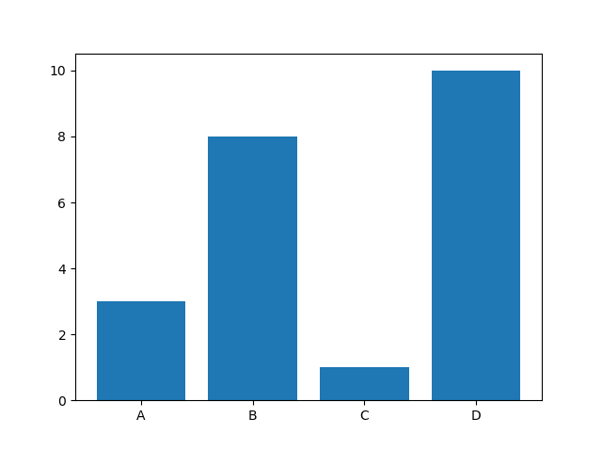
Basic Chart Type 1: Bar Chart
What it shows: Comparisons between different categories.
When to use: Comparing sales by product, number of students in different subjects, votes for different options.
Example: Showing test scores for Math, English, and Science.

Slide 7
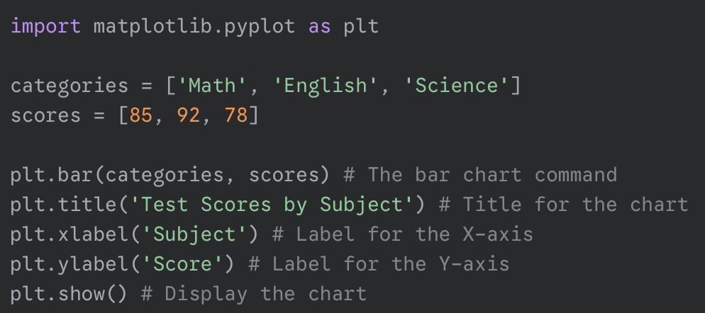
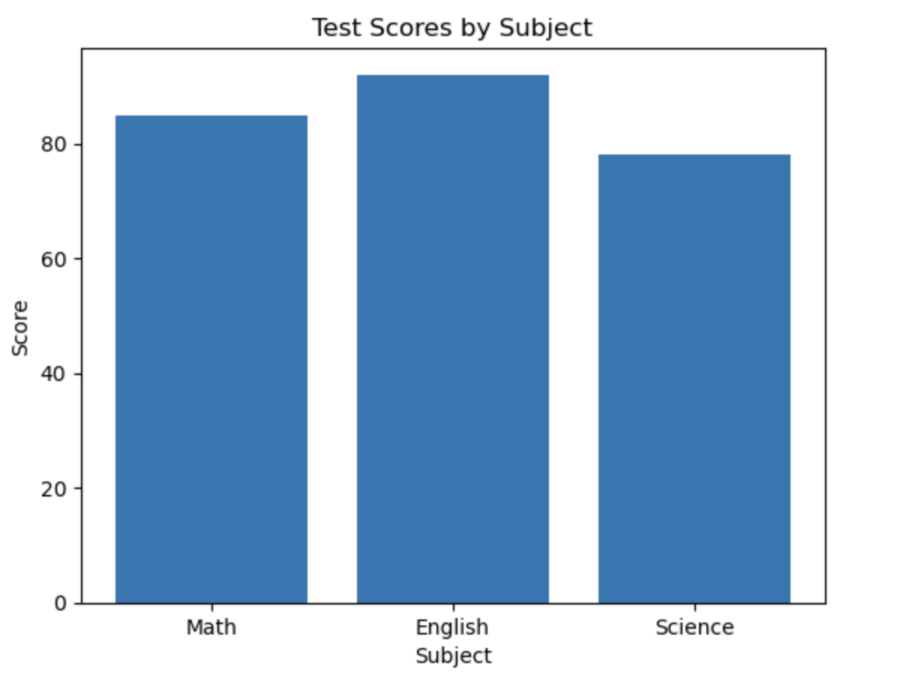
Bar Chart Example

Slide 8
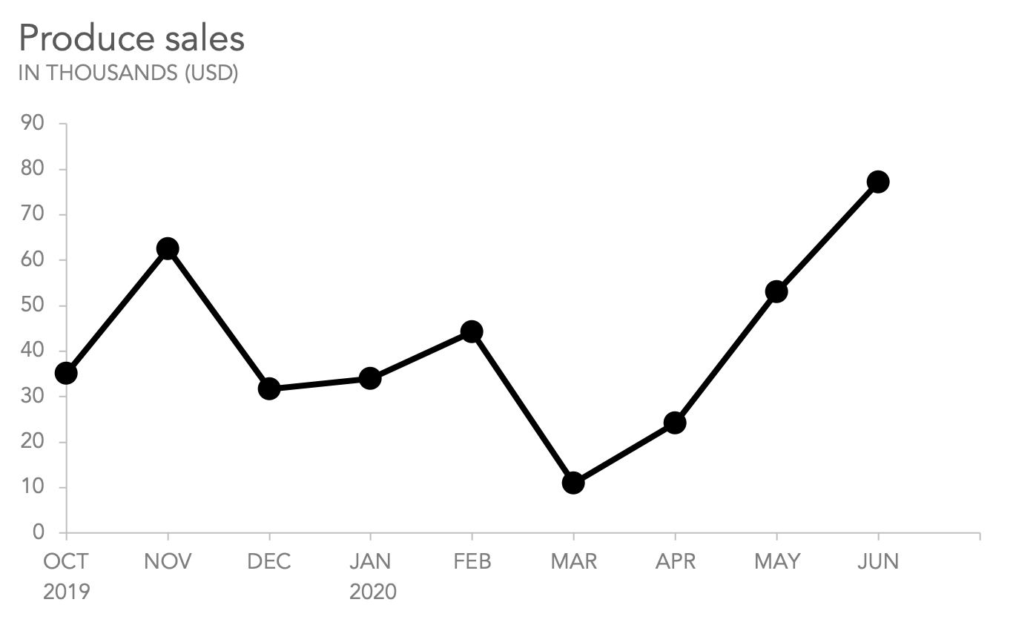
Basic Chart Type 2: Line Chart
What it shows: Trends over time or continuous changes.
When to use: Stock prices over months, temperature changes over a year, population growth.
Example: Showing temperature trends across different months.

Slide 9
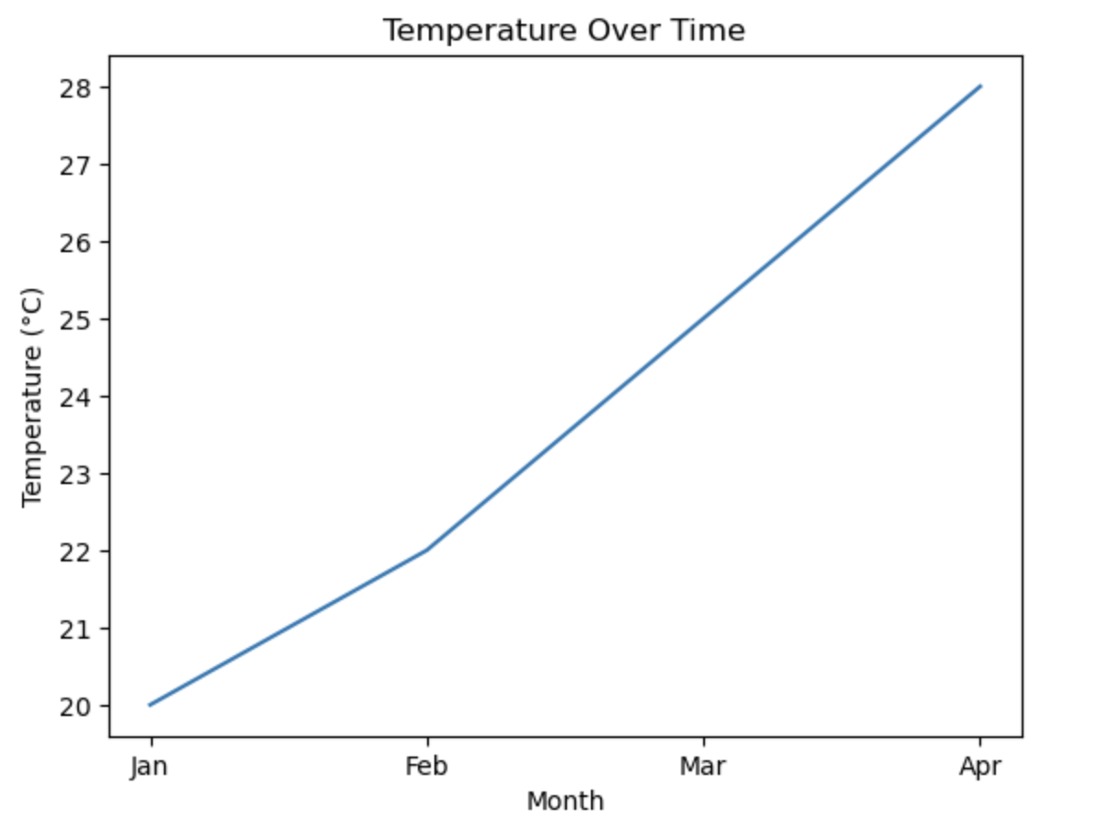
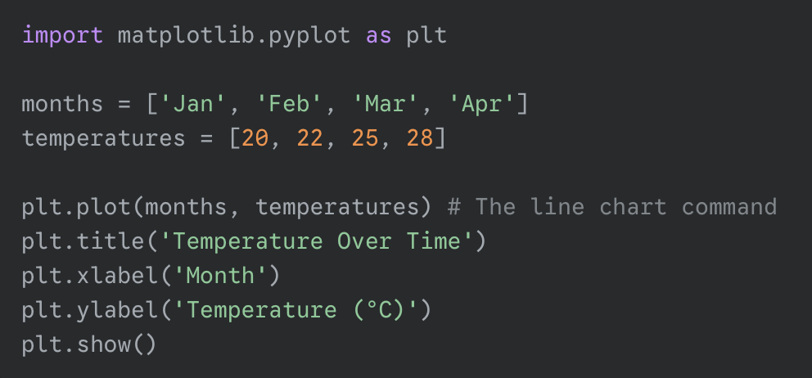
Line Chart Example

Slide 10
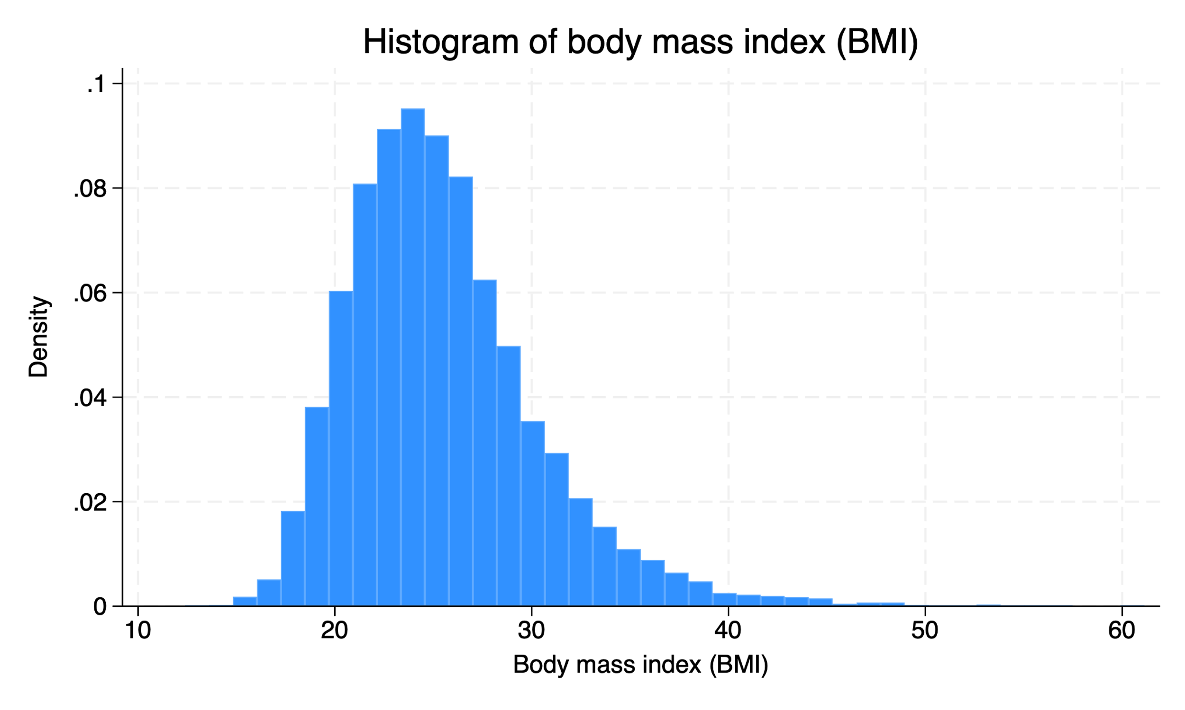
Basic Chart Type 3: Simple Histogram
What it shows: The distribution of a single numerical variable. How often different values appear.
When to use: Distribution of student ages, spread of test scores, frequency of product prices.
Example: Showing how many students fall into different age groups.

Slide 11
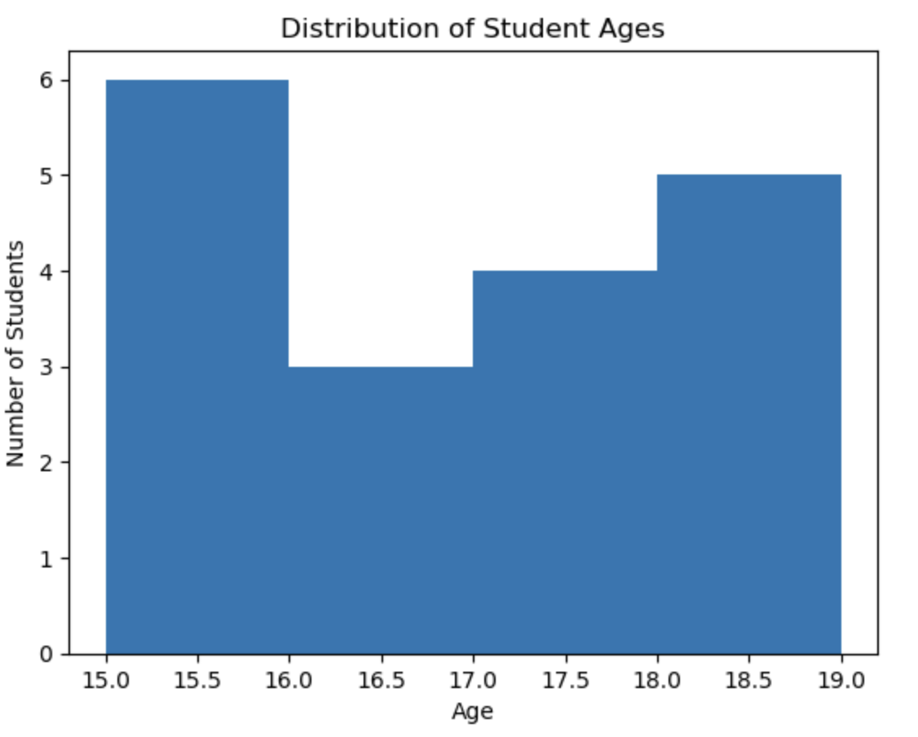
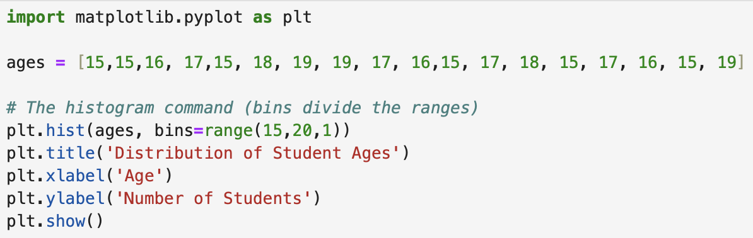
Histogram Example

Slide 12
Basic Chart Type 4: Pie Chart
What it shows: Parts of a whole or percentage breakdown of categories.
When to use: Market share distribution, budget allocation, survey responses with percentages.
Example: Showing different expense categories in a monthly budget.

Slide 13
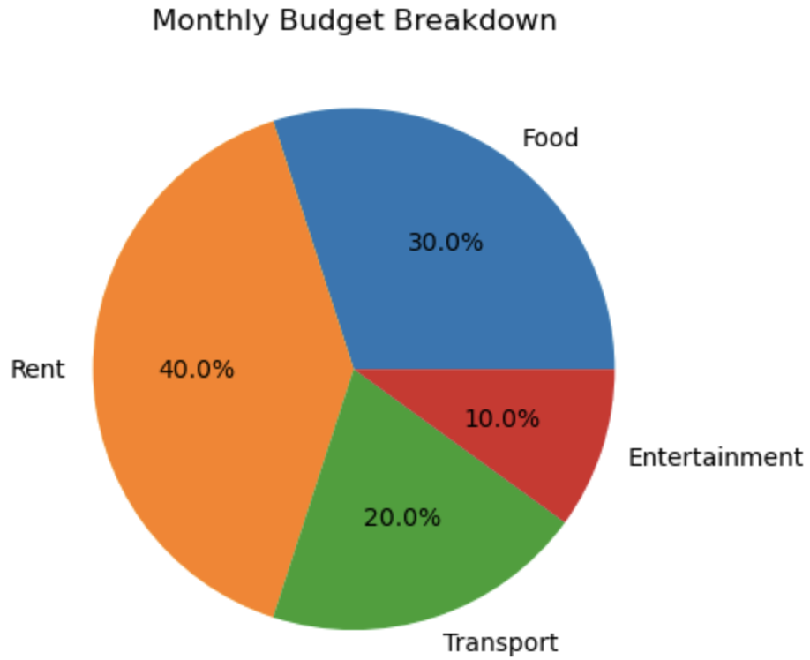
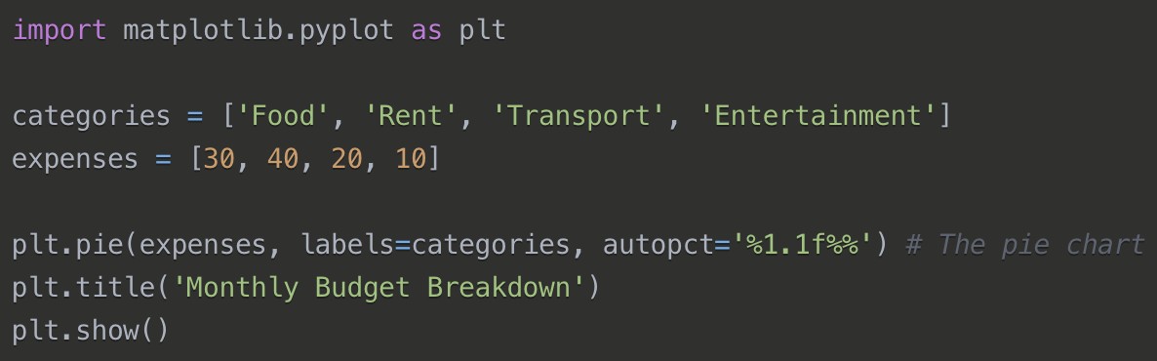
Pie Chart Example

Slide 14
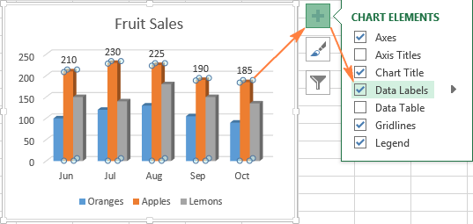
Making Charts Look Good: Colors and Size
Colors: You can specify colors for bars or lines (e.g., color='blue' or color=['red', 'green', 'blue’]).
Size: Make your charts fit nicely in your notebook or presentation (plt.figure(figsize=(width, height))).
Font Size: Make text readable (fontsize=14).

Slide 15
Complete Analysis Process: Step-by-Step
Step 1: Start with a Question
Data analysis isn't just coding; it's a thinking process.
We'll follow a simple, repeatable workflow.
This is how real data analysts work!
Step 2: Load and Clean Your Data
Step 3: Explore with Simple Calculations
Step 4: Create Charts to Show Patterns
Step 5: Write Simple Explanations

Slide 16

Step 1: Start with a Question
Don't just randomly look at data. Have a goal!
Examples: "Are students who study more getting better scores?", "What's the most popular product?", "How many people prefer bus transportation?”
The question guides your analysis.

Slide 17

Step 2: Load and Clean Your Data
Load your data using pd.read_csv().
Check for and handle missing values (isnull().sum(), dropna(), fillna()).
Check for and handle duplicates (drop_duplicates()).
Convert data types if necessary (pd.to_numeric()).

Slide 18

Step 3: Explore with Simple Calculations
Use Pandas functions to get basic facts about your data.
df.head(), df.info(), df.describe()
df['Column'].mean(), sum(), max(), min().
Sort and filter to narrow down your focus.
Create new columns if needed.

Slide 19
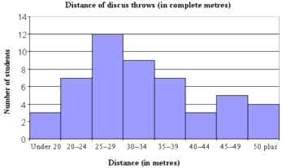
Step 4: Create Charts to Show Patterns
Choose the right chart type for your question (Bar, Line, Histogram).
Use Matplotlib to create clear, well-labeled charts.
Charts reveal relationships and trends that numbers hide.

Slide 20

Step 5: Write Simple Explanations
What do your charts and calculations mean?
Summarize your findings in 2-3 clear sentences.
Answer your initial question!
Example: "The most popular subject is Math, chosen by 4 out of 10 students."

Slide 21
Task 1: Start with a Question
Write down three questions you want to answer using the student_survey.csv dataset.
  Examples:
    Which subject is the most popular among students?
    Is there a relationship between study hours and test scores?
    How are student ages distributed?

Slide 22
Task 2: Load and Inspect the Data
Load student_survey.csv into a Pandas DataFrame using pd.read_csv().
Display the first 5 rows using df.head().
Check the data types and basic info using df.info().
Summarize numerical columns using df.describe().

Slide 23
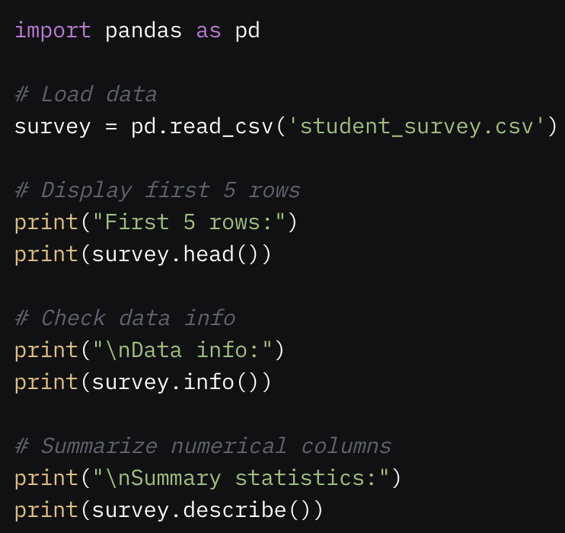
Task 2: Code
Expected Output: Table of first 5 rows, data types (e.g., Age as float64 due to NaN, Test_Score and Hours_Study_Per_Day as float64, others as object or int64), and summary stats (e.g., mean Test_Score ~86, mean Age ~19 but skewed by the outlier).

Slide 24
Task 3: Clean the Data
Check for missing values using survey.isnull().sum().
Handle missing values:
  For Age, fill missing values with the median age (survey['Age'].median()).
  For Test_Score, fill missing values with the mean score (survey['Test_Score'].mean()).
Check for duplicates using survey.duplicated().sum() and remove them with survey.drop_duplicates().
Fix the outlier in Age (e.g., 99 is unrealistic). Replace ages > 18 with the median age.
Verify the cleaned data with survey.isnull().sum() and survey.describe().

Slide 25
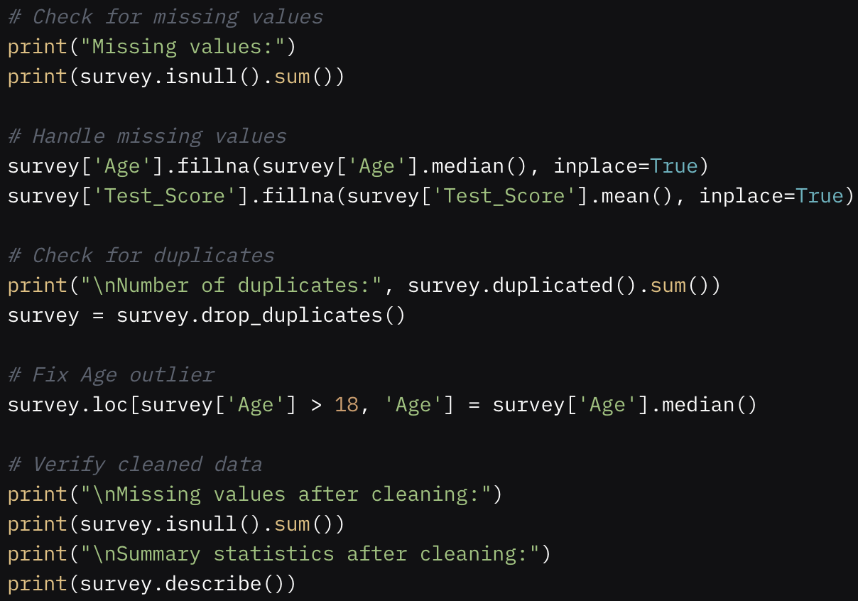
Task 3: Code
Expected Output:
Initially, 2 missing in Age, 2 in Test_Score, 2 duplicates; after cleaning, 0 missing, 0 duplicates, Age max ≤ 18.

Slide 26
Task 4: Explore with Simple Calculations
Calculate the average Test_Score and Hours_Study_Per_Day.
Count the number of students per Favorite_Subject using value_counts().
Count the number of students per Transportation method.
Find the maximum and minimum Attendance_Days.

Slide 27
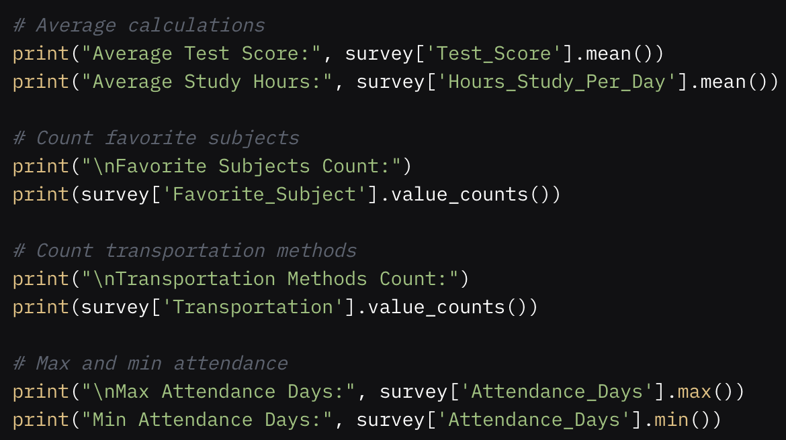
Task 4: Code
Expected Output:
Approximate values (e.g., mean
  Test_Score ~86.5, mean
  Hours_Study_Per_Day ~2.47
Subject counts are,
  History 10
  Science 9
  English 6
  Math 5
Attendance_Days range 15–20.

Slide 28
Task 5: Create a Bar Chart
Create a bar chart showing the count of students per Favorite_Subject.
Include a title, x-label, and y-label.
Use a custom color (e.g., 'skyblue') and set figure size to (8, 5).
Make the font sizes readable (e.g., 14 for title, 12 for labels).

Slide 29
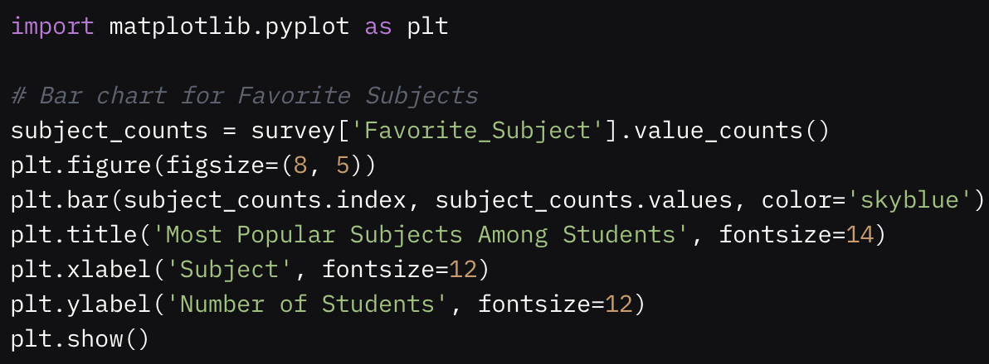
Task 5: Code
Expected Output:
A bar chart with 4 bars (Math, English, Science, History),labeled and visually appealing.

Slide 30
Task 6: Create a Line Chart
Create a line chart showing the average Test_Score for each Attendance_Days value.
Group the data by Attendance_Days and compute the mean Test_Score using survey.groupby('Attendance_Days')['Test_Score'].mean().
Include a title, x-label, y-label, and a grid for readability.

Slide 31
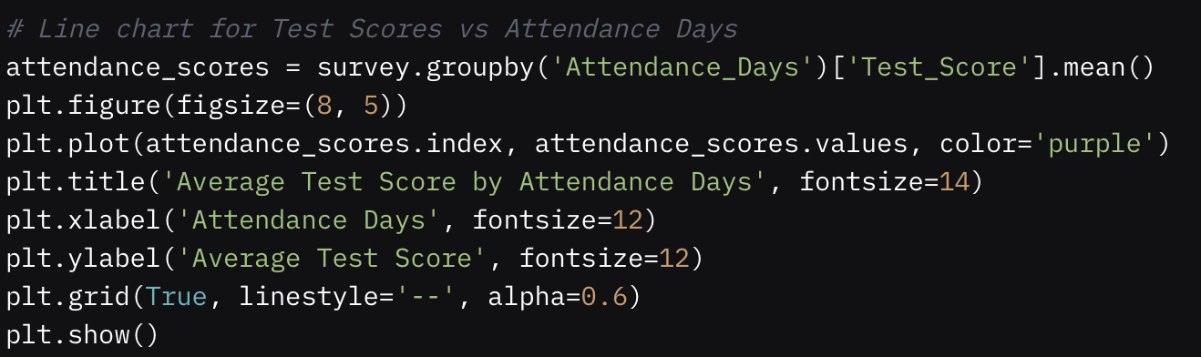
Task 6: Code
Expected Output:
A line chart showing average test scores (likely ~80–90) across attendance days (15–20), with slight variations.

Slide 32
Task 7: Create a Histogram
Create a histogram of Age to show the distribution of student ages.
Use bins [14.5, 15.5, 16.5, 17.5, 18.5] to group ages.
Include a title, x-label, and y-label.

Slide 33
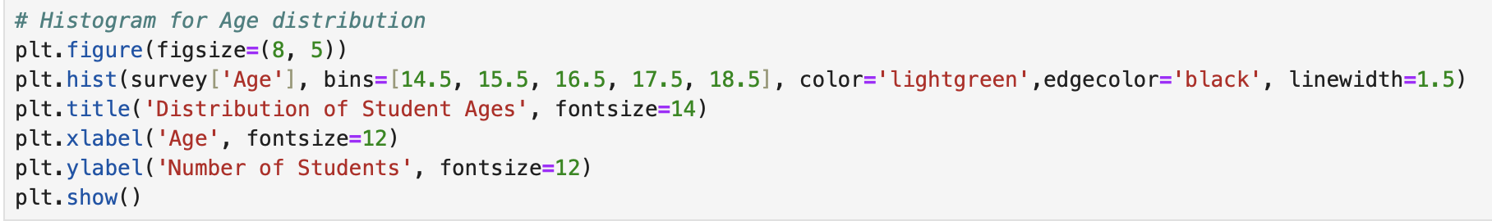
Task 7: Code
Expected Output:
A histogram with most students in the 17 age range, fewer at 15, and clear bin boundaries.

Slide 34
Task 8: Create a Scatter Plot
Create a scatter plot of Hours_Study_Per_Day vs. Test_Score to see if more study hours relate to higher scores.
Include a title, x-label, y-label, and a grid. Use alpha=0.7 for slight transparency.

Slide 35
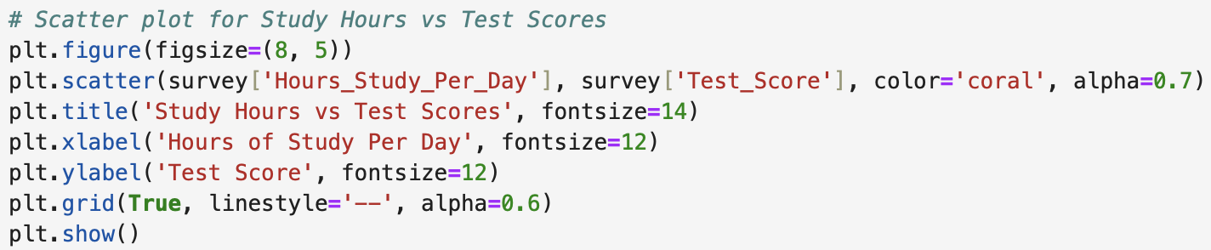
Task 8: Code
Expected Output:
A scatter plot showing a possible weak positive trend (more study hours slightly associated with higher scores).

Slide 36
Task 9: Write Simple Explanations
Based on the charts and calculations from Tasks 4–8, answer your three questions from Task 1.
Write 2–3 sentences for each question, explaining what the data shows.
Example for “Which subject is most popular?”:
  “History is the most popular subject, with 11 students choosing it, followed by Science with 9 students. English and Maths are less popular, each with around 6 students.”

Slide 37
Q & A

